Slide 1

Kaggle Fraud Detection
Team: Luke Gray, Alyssa Wei, Jose Gonzalez,
Fred(Lefan) Cheng and Rajesh Earlu

Slide 2
Table of Contents
Project Description
Important Features and Variables
Exploratory Data Analysis (EDA)
Missingness and Imputation
PCA and Feature Engineering
Balancing Techniques
Modeling
Scoring
Future Work

Slide 3

Project Description
We completed the IEEE-CIS (Institute of Electrical and Electronic Engineers) Fraud Detection competition on Kaggle
The dataset of credit card transactions is provided by the Vesta Corporation, described as the world’s leading payment service company
The dataset includes identity and transaction CSV files for both test and train
Train dataset: 590540 x 433; Fraud transactions: 20663
Target variable ‘isFraud’
Notes:
Considering changing this slide and putting both the graphics on the current 1 and 2 slides into a single combined slide.
Also should I put the stuff about the memory reduce function and how it’s the largest dataset we have worked with?

Slide 4
Important Features and Variables
TransactionDT: timedelta from a given reference datetime (not a timestamp)
TransactionAMT: transaction payment in USD
ProductCD: product code, the product for each transaction
card1-card6: payment card information, such as card type
addr: address
dist: distance
P_ and (R_)emaildomain: purchaser and recipient email domain
C1-C14: counting, addresses and other things, actual meaning is masked.
D1-D15: timedelta, such as days between previous transaction, etc.
M1-M9: match, such as names on card and address, etc.
Vxxx: Vesta engineered rich features, including ranking, counting, and other entity relations.
Notes:
Even if we do not include this slide, we have to bring up the fact that the data is partially masked to protect the identity of the clients involved in the transactions.

Slide 5
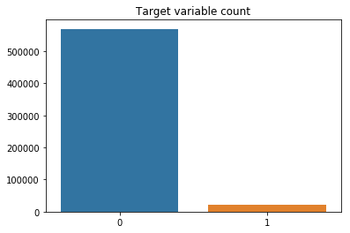
Exploratory Data Analysis (EDA)
One of the first things we noticed when conducting our EDA was the sparsity of the dataset
Only ~3.5% of the total transactions were positively classified as part of the ‘isFraud’ variable
Notes:
We realized that not all transactions have corresponding identity information.
There was also a lot of missingness and in the dataset that we needed to impute.

Slide 6
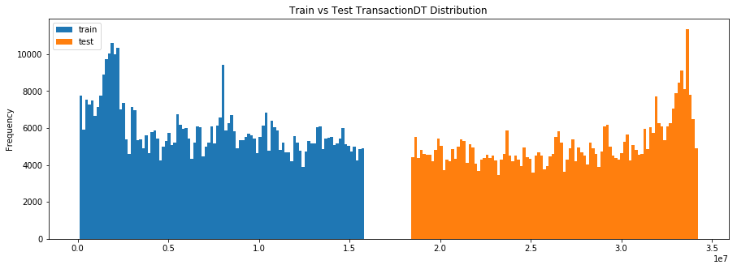
EDA
Another observation was immediately apparent is imbalanced nature of the data. This shows that ‘TransactionDT’ is a timedelta gap, not a timestamp
Notes:
Talk about how this proves that train was collected before test

Slide 7
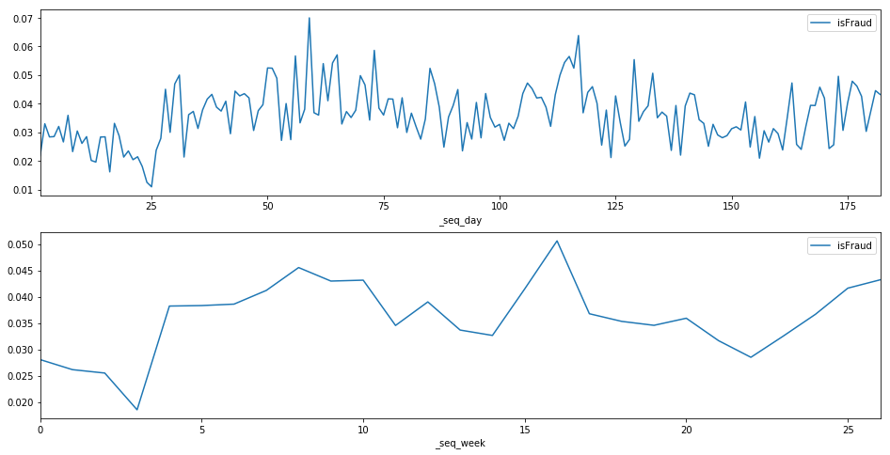
EDA Timedelta
Notes:
Can be removed

Slide 8
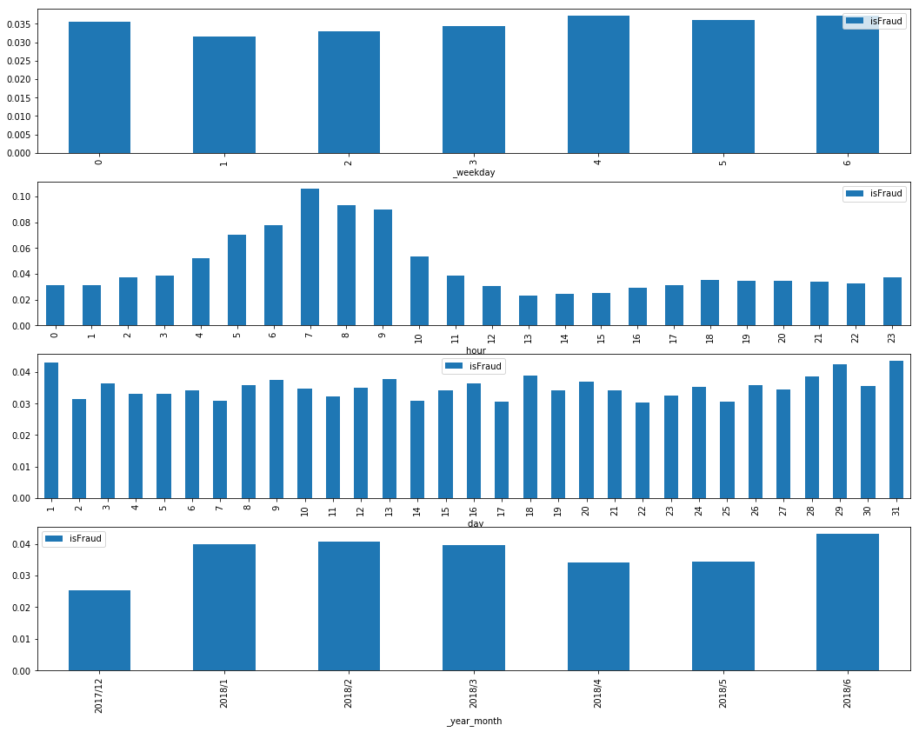
EDA Timedelta
Notes:
Can be removed

Slide 9
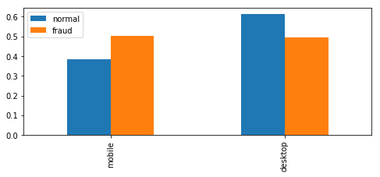
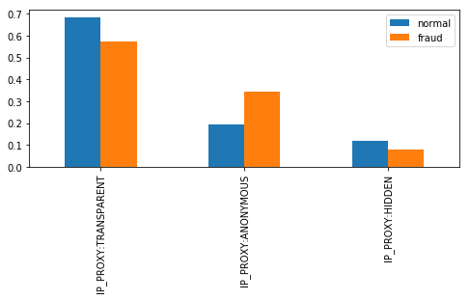
EDA
Target variable ‘isFraud’ is more prevalent in the mobile ‘DeviceType’ as well as more prevalent in the ‘IP_PROXY:ANONYMOUS’ based on ‘id_31’
Visualizations of other interesting findings below:
Notes:
‘isFraud’ is more prevalent on the ‘mobile’ ‘DeviceType’
‘isFraud’ more prevalent in ‘IP_PROXY:ANONYMOUS’

Slide 10
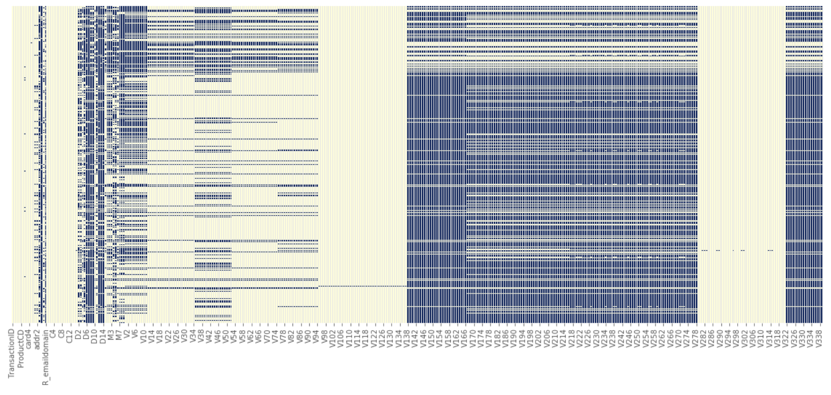
Missingness and Imputation
Dataset has very high percentage of missing values, especially the V columns.

Slide 11
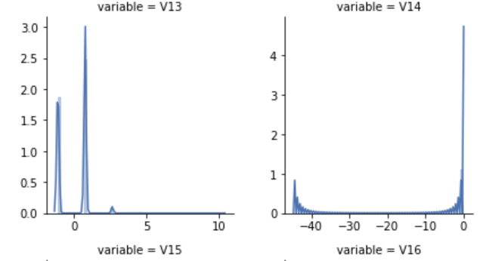
Missingness and Imputation
Anonymized columns not only had a high mount of missing data, but their distributions weren’t normal.

Slide 12
Missingness and Imputation
Plan A:
Drop columns with over 80% of missing value.
Impute columns with less than 20% missing values by the mean of each row’s product ID.
Use machine learning model with the columns without missing value as input variables to predict the remaining missing values.
Precise but time consuming.
Hard to impute for anonymized data.
Plan B:
Impute all the missing values with -999 first which is very fast and model can still find some pattern instead of losing information by dropping them.
Do more complex imputation afterwards if we have extra time.

Slide 13
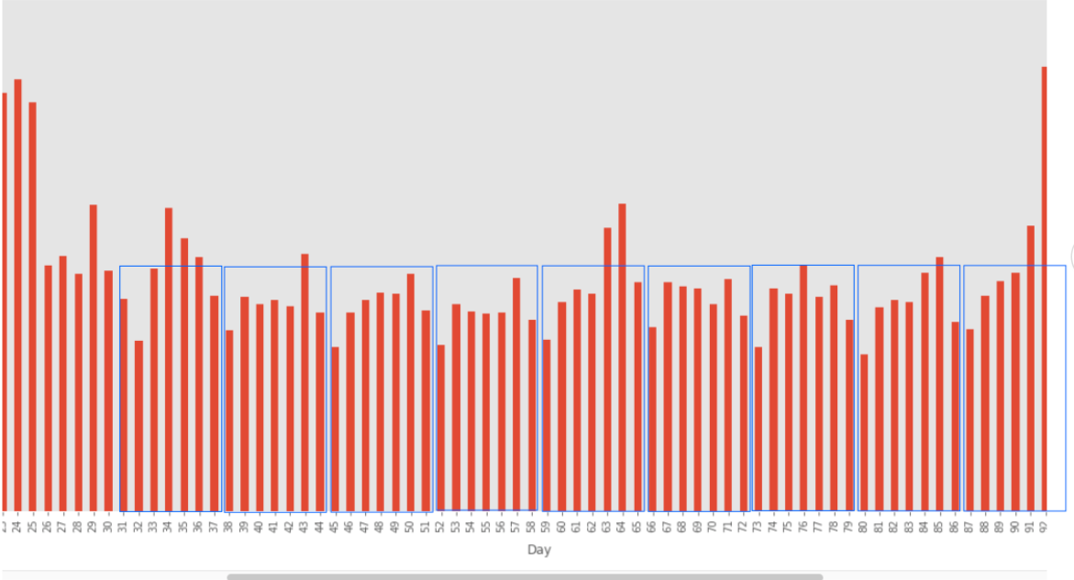
Feature Engineering
Given the sparsity and anonymity of our data, feature engineering was a central focus of the project.
The most intuitive way to tackle this was first engineering on known features, namely, the TransactionDT and TransactionAmt.

Slide 14
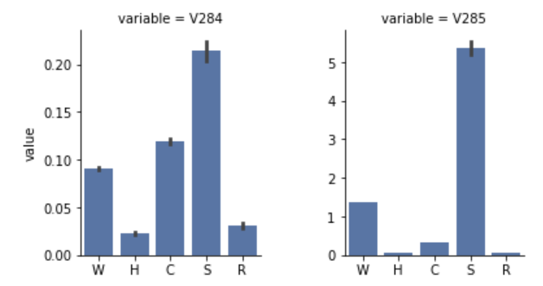
Engineering on Anonymized V-columns
Considering that V columns occupied most of our data and engineered by the company themselves we indexed on the trends in those values to impute.

Slide 15
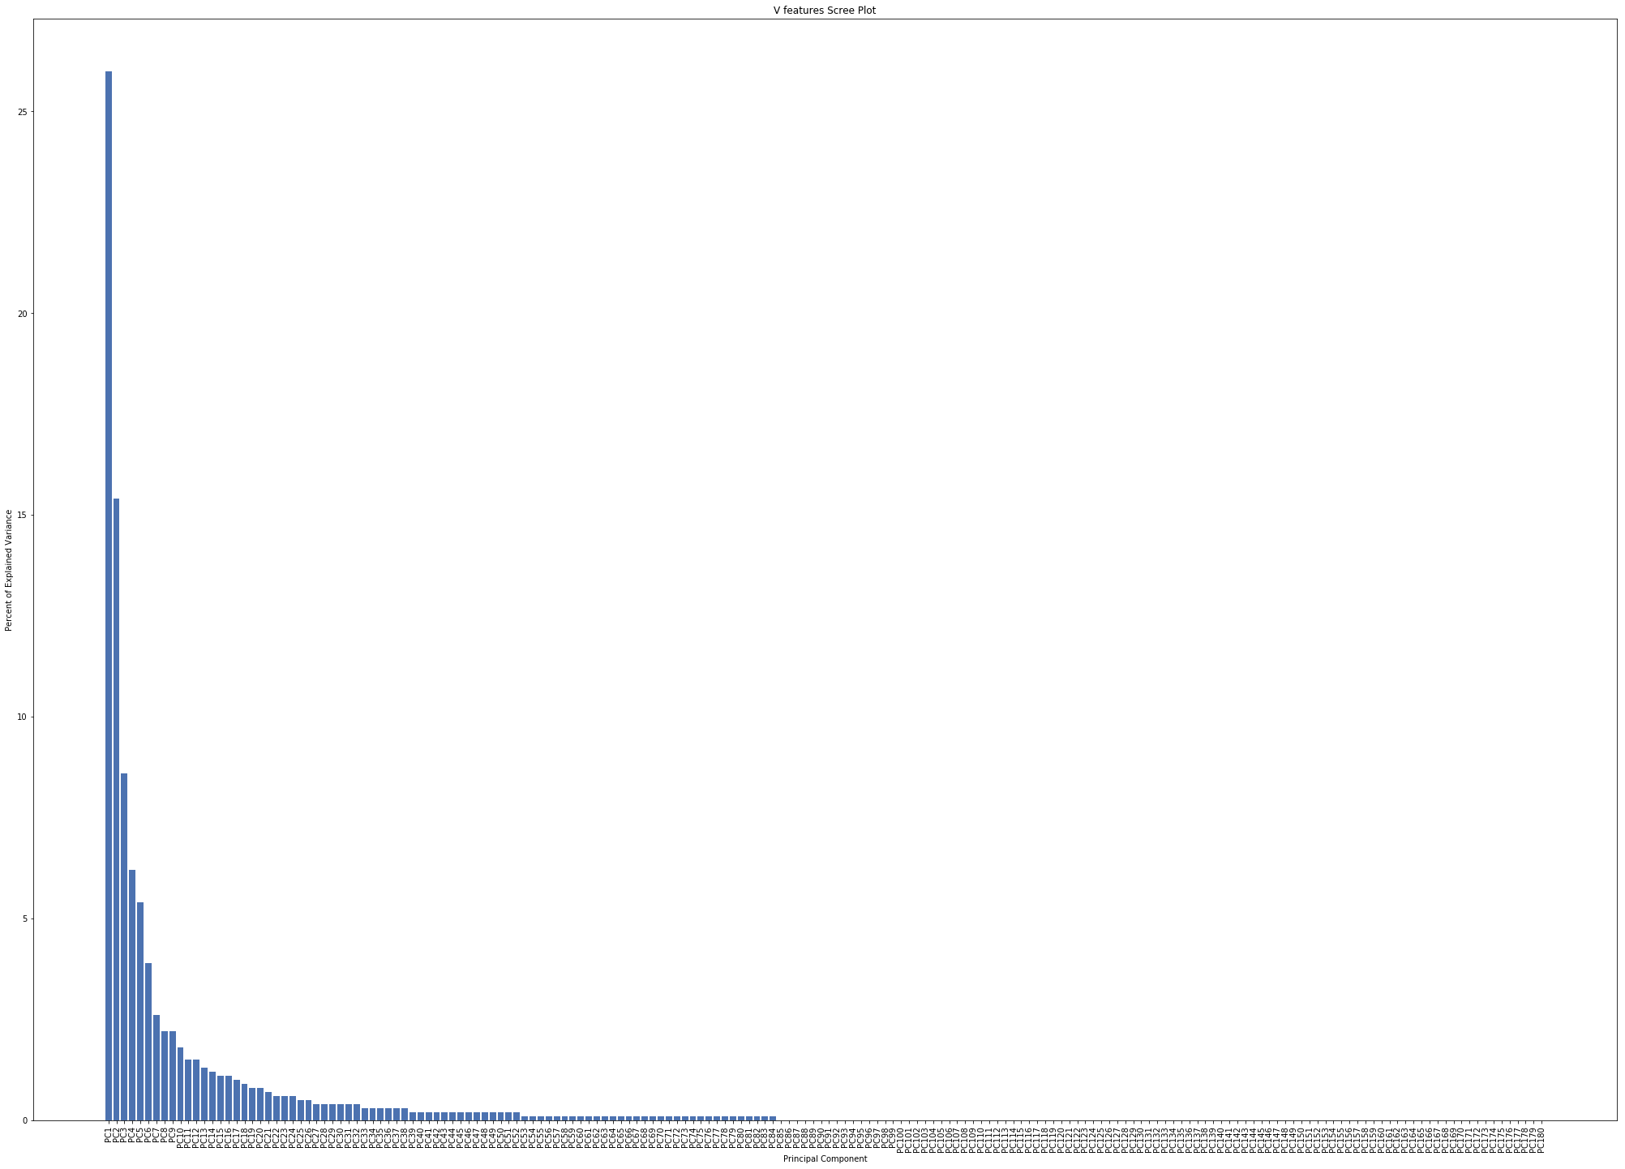
Dimensionality Reduction
Attempted:
PCA
Lasso
Sparse PCA
It was essential to run PCA before balancing the created values from oversampling wouldn’t be influenced by uninformative features.

Slide 16
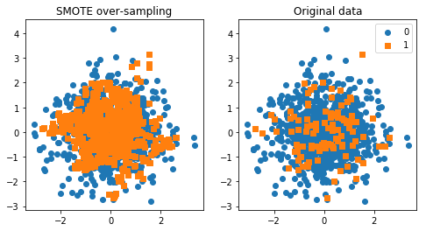
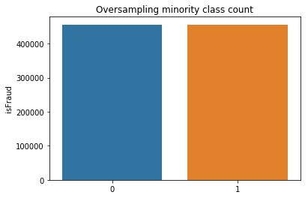
Balancing Techniques
To help with the imbalance we showed earlier, we used balancing techniques such as oversampling the minority class.
We ultimately used SMOTE, which is shown graphically below:

Slide 17
Modeling
XGBoost
Accuracy: 0.98
Precision: 0.75
Recall: 0.45
LightGBM
AUC: 0.972328

Slide 18
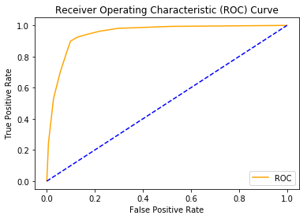
Scoring
Competition submissions evaluated on area under the ROC curve between predicted probability and the observed target.
A graphical example made on sample data is shown below:
Notes:
Recall = TP / (TP + FN). Out of all the positive classes, how many were identified correctly.
Precision = TP / (TP + FP). Out of all the predicted positive instances, how many were identified correctly.

Slide 19
Future Work
If we had more time to work on this project:
We would utilize cloud computing services.
Before oversampling and feature engineering, our workspace could only handle so much before running into Memory Errors.
The amount of data also made grid-searching impossible unless only considering a very limited range of hyperparameters.
Further feature engineer to help deal with the sparsity of our data.
Proper optimization techniques
GridSearchCV, bayes_opt, GPyOpt, stratified KFold

